Slide 1
Compile all team members’ scores together to have a comprehensive view of the team’s perceptions (done by the module guru).
Analyze the total scores for each dysfunction
A score between 9-8 indicates no problem
7-6 indicates a possible problem
3-5 indicates a serious problem.
Team member name | Dysfunction 1: Absence of trust | Dysfunction 2: Fear of conflict | Dysfunction 3: Lack of commitment | Dysfunction 4: Avoidance of accountability | Dysfunction 5: Inattention to results
Arjun | 6 | 4 | 9 | 8 | 7
Meera | 6 | 6 | 7 | 7 | 7
Abhay | 8 | 8 | 7 | 9 | 7
Alfred | 7 | 7 | 8 | 5 | 7
Eric | 7 | 4 | 8 | 8 | 7
Basakran | 7 | 3 | 8 | 8 | 8
PHP
Navishka | 6 | 6 | 7 | 6 | 7
Avg team scores | Absence of Trust | Absence of Trust | Lack of commitment | Avoidance of accountability | Inattention to results
Average = 6.62 | 6.72 | 5.42 | 7.71 | 6.14 | 7.14

Slide 2
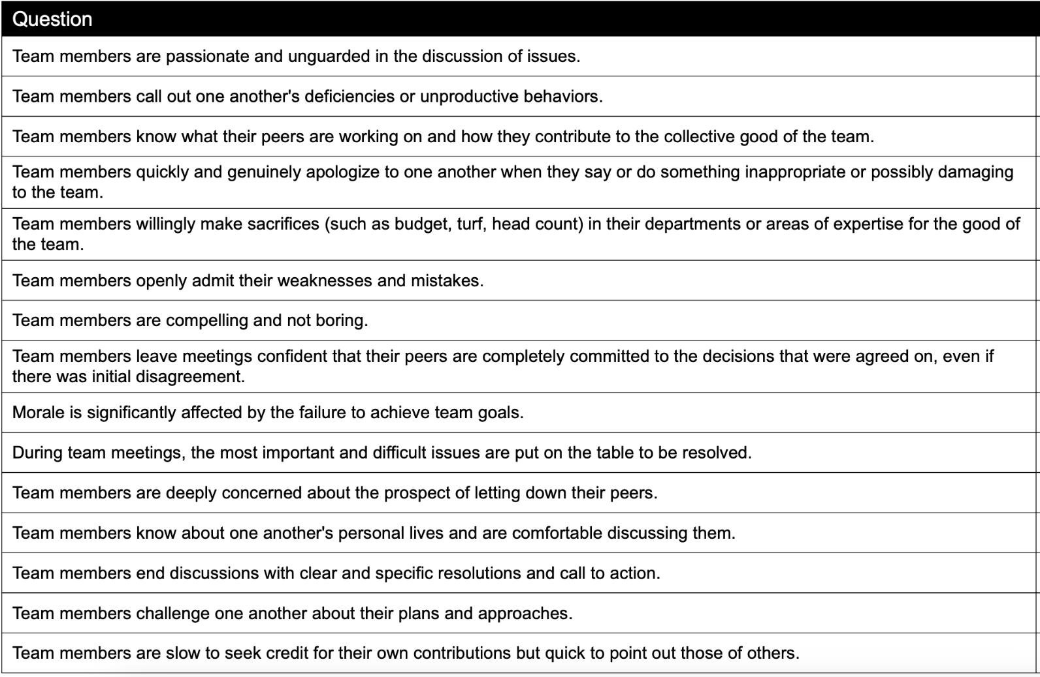
Score | Filled out by Arjun, Alfred, Abhay, Eric and Baskaran together
8,8,7,5,5
5,7,8,5,5,
5,5,5,7,5
5,5,8,5,7
8,8,7,8,8
7,6,6,8,7
9,8,8,8,9
7,7,8,6,7
8,8,8,7,8
8,8,7,6,5
7,6,6,5,7
5,4,4,5,4
5,6,5,5,6
5,6,6,5,5
7,6,6,5,6

Slide 3
With the scores at hand, initiate an open and honest discussion within the team (during the Fast Track hour). Talk about the areas of strength, acknowledge the challenges, and collectively brainstorm on actionable steps to overcome the dysfunctions. In the end, choose the most important 3 action points you want to implement first, assign a responsible person and a deadline.
Dysfunction | Team score | How can it be addressed
ABSENCE OF TRUST | 6.72 | This can be improved on with better communication and weekly meetings
FEAR OF CONFLICT | 5.42 | This can be improved on with better communication and weekly meetings between different departments
LACK OF COMMITMENT | 7.71 | We are all very committed. Now that we have better clarity on the company dream and the values, this has been helpful to improve our team members commitment as they better understand what they are committing to. This can still be improved by aligning all the other team members and creating a company culture around these values and the dream
FEAR OF AVOIDANCE OF ACCOUNTABILITY | 6.14 | By better measuring the results we will hold people more accountable. They should not fear their responsibilities and this
INATTENTION TO RESULTS | 7.14 | The results are there, and the data is being collected but not analysed collectively as team. We need to discuss the data in more detail including financial performance data. This needs to be addressed through either hiring a different finance manager or through shifting of responsibilities
What | Who | When
Communicate the dreams and values, Top 5 relevant Cool and Non-Cool behaviours to all staff in all departments (Production, Quality control, Sales, accounts and finance, dispatch, maintenance teams) | Team leaders (Arjun, Navishka Eric, Basakran) & Pradeep (chairman) | By April 30th
Better monitoring sales and dispatch performance and communicating this (measuring how quickly orders are fulfilled and who is responsible for the sales) | Meera, Alfred and Arjun | By April 30th
To better analyze financial Data – Arjun needs to spend more time here with Alfred and the accounts team building a better format of analysis and data discussions | Arjun & Alfred | By May 15th

Slide 4
Dysfunction | Who | What | When
ABSENCE OF TRUST | Team Leader | Begin team meetings by sharing a personal story or a significant past challenge, encouraging others to do the same. | First 10 minutes of each team meeting.
 | All Team Members | Participate in a scheduled workshop using r Thomas PPA to explore and discuss each person’s traits and how they impact team dynamics. | Schedule within the next 30 days, then bi-annual refresh sessions.
FEAR OF CONFLICT | Team Leader | Facilitate a session to discuss hypothetical sensitive issues that could arise in projects, guiding the team through structured debates. | During the next monthly strategic meeting.
 | All Team Members | Collaboratively develop and sign a conflict engagement charter using insights from the Thomas-Kilmann Instrument, outlining how to handle disagreements. | Implement in the next team meeting; annually review and update.
LACK OF COMMITMENT | Team Leader and Members | Explicitly state commitments at the end of each meeting, requesting each member to verbally agree or express disagreements before committing. | Last 10 minutes of every team meeting.
AVOIDANCE OF ACCOUNTABILITY | Team Leader | At the start of each quarter, clearly outline individual and team goals, making these visible in the workplace and revisiting them in weekly updates. | First team meeting of each quarter.
 | All Team Members | Schedule peer-review sessions where team members provide specific feedback on each other’s contributions compared to the set goals. | Scheduled midway and at the end of each project phase.
INATTENTION TO RESULTS | CEO | Set up a scoreboard that tracks team progress against goals. Update and review this scoreboard in weekly team meetings. | Set up within the first week of the project
 | Team Leader | Hold end-of-project retrospectives to assess the achievement of goals and discuss lessons learned and strategies for future improvement. | At the end of each project or quarterly cycle.

